Slide 1

GTA Briefing and Lab Safety
Ma Xiangyu
TAC of Physics Department
20 Aug 2019

Slide 2

Attendance taking
Please make sure that you have signed for attendance.
Your signature on the attendance sheet is the only evidence of your attendance.
No appeal case is accepted if your signature is NOT found.

Slide 3
outline
PART I
Get to know each other
Introduce the roles and responsibilities of GTAs
Academic study in physics department
PART II
Safety Matters in Conducting Laboratory

Slide 4
Outline
PART I
Get to know each other
Introduce the roles and responsibilities of GTAs
Academic study in physics department

Slide 5

Welcome Speech from the Postgraduate Coordinator (PGC)
Prof. Gyu-Boong JO
Tel: (852) 2358 5954
Office: Room 4434
E-Mail: gbjo
http://6iee.com/702904.html

Slide 6

Self introduction
---Name
---Undergraduate university
---Hobbies
---Hometown
…

Slide 7
Self Introduction
My name: Ma Xiangyu（馬翔宇）
PhD year-3 (Prof. K. Y. Michael Wong )
Undergraduate: Nanjing University
Hobbies: swimming, reading…
Hometown: Anqing, Anhui
Email: xmaal@connect.ust.hk
Tel: 53951814

Slide 8
Self Introduction
Your turn!
---name
---undergraduate university
---hobbies
---hometown
…
Clear Water Bay Young Scholar Club
（清水湾青年学者交流会）
QQ Group: 305037811

Slide 9
Self Introduction
Now you know each other.
Let’s play a small game ☺
Can you tell us the name of the person next to you?
---- Really?
His/Her name is …

Slide 10
OUTLINE
PART I
Get to know each other
Introduce the roles and responsibilities of GTAs
Academic study in physics department

Slide 11
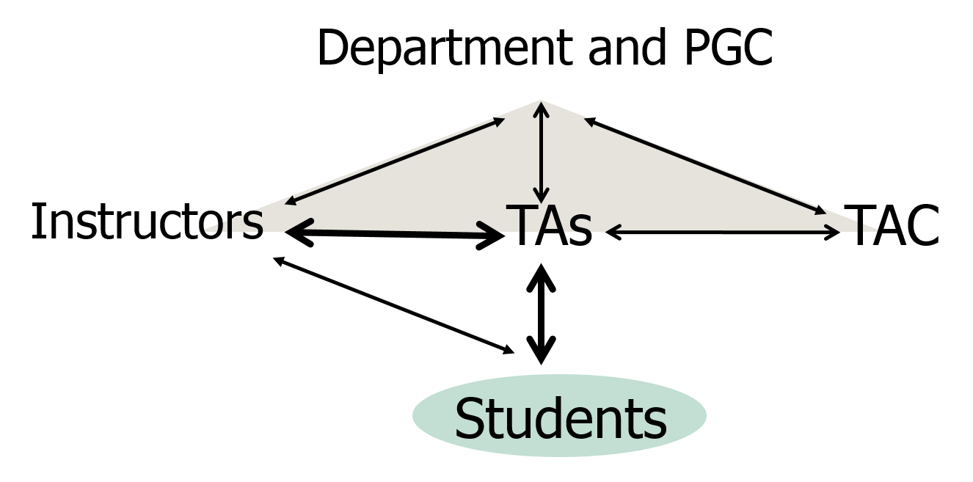
Teaching network
GTAs

Slide 12
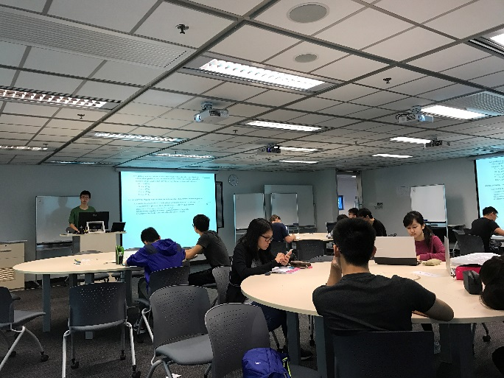
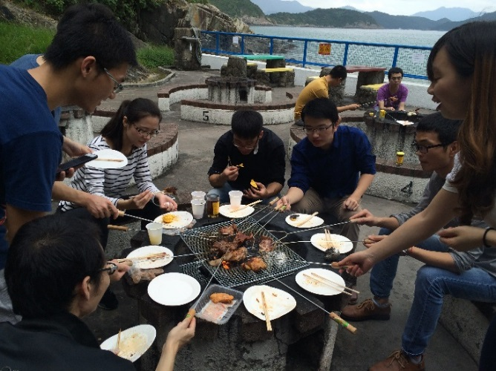
TAC – Teaching Assistant Coordinator
What does TAC do?
--- Provide assistance to GTAs
--- Conduct evaluation on GTAs’ performance
--- Communicate between department and GTAs
--- Hold departmental GTA activities

Slide 13
GTA – Graduate Teaching Assistant (Old name: TA)
As a PG student in UST:
Academic Research
GTA duties*
* In physics dept., GTA is compulsory for every RPG (MPhil, PhD).

Slide 14
GTA Training Program
Required for all GTAs
For non-local graduates:
GTA trainings in 1st semester (workshops provided by CEI),
Start GTA duties from 2nd semester.
For local graduates:
Start GTA duties from 1st semester.

Slide 15
GTA duties
Major duties include*:
Conducting tutorials & lab sessions
Marking and grading assignments, examinations or lab books
Preparing course materials e.g. notes & solutions etc.
Maintaining course website
Performing administrative work
Help with the demonstrations in class
…
* Varies with courses.

Slide 16
Start as a GTA
Get confirmation of GTA assignment from our department
Contact the course instructor to seek for course requirement (GTAs’ duties)
For examples:
Are you required to attend lectures?
Do you need to assist the course instructor to prepare teaching materials or maintaining course website?
Do you meet with the course instructor regularly?

Slide 17
What should I do? ——Marking and grading on Assignments
Prepare solutions for assignments
Prepare the marking scheme
Mark and grade the assignments consistently according to the marking scheme
Team work between GTAs

Slide 18
What should I do? ——Examinations
Invigilate during examinations
Prepare solutions for examinations
Prepare the marking scheme
Mark the exam paper consistently according to the marking scheme

Slide 19
What should I do? —— Outside classes
Provide consultation service to students,
for example, answering students’ questions…
Carry out administrative work
such as recording the marks of assignments and examinations
Maintain the course website

Slide 20
What should I do? —— Lab sessions
Contact with technicians and pre-lab before the sessions
Provide help to students during the sessions

Slide 21
What should I do? —— Tutorial
Prepare tutorial material before the sessions
Come to the classroom on time
Tell students what you are going to teach and what they have to do in the tutorial
Speak clearly!
Speak loud, (try to) use standard English

Slide 22
GTA Evaluation
All the GTAs will be evaluated at the end of each semester
Students will evaluate the performance of GTAs
Poor evaluation results may cause the deduction of studentship
Best GTA awards will be announced and awarded in our Department Ceremony

Slide 23
Discussion ——Communication with instructors and students
With instructors:
Mainly by email, set an appointment
Prepare relevant documents to the instructors before the meeting
With students:
Mainly by email, meet during office hours
Behave professionally as a teacher, tell the students the date when you can reply them in case you do not know the answer and need some time to prepare for it.
Be punctual!

Slide 24
Discussion
Balance time between GTA work and your own research
Whom to contact if facing problems
Supervisor
TAC
PGC
CEI
Senior PG students
Counseling & Wellness Office

Slide 25
OUTLINE
PART I
Get to know each other
Introduce the roles and responsibilities of GTAs
Academic study in physics department

Slide 26
Course Information
Offered by Physics Department:
MPhil in Physics and PhD in Physics.
Offered by NSNT(Nano Science and Technology ) Program:
MPhil and PhD in NSNT
Course Requirement
MPhil and PhD in Physics & Mphil in NSNT: 12 credits
PhD in NSNT : 15 credits.

Slide 27
Course Information
Required to complete and pass:
LANG 5010 Postgraduate English for Science Studies (within 1st year)
PHYS 6770 Professional Development in Science (within 1st year)
(The credits earned from PHYS 6770 and LANG 5010 CANNOT be counted toward the
credit requirements.)
Detailed course requirements:
http://www.phys.ust.hk → Programs & Admissions → Postgraduate programs → Programs for postgraduates → link

Slide 28
PhD Qualifying Exam (QE)
PhD students are required to pass the QE before the 4th academic year.
The QE consists of a written report and an oral presentation.
Students are allowed to attempt the QE twice at most.
Information about QE:
https://intranet.phys.ust.hk/phd_exam/

Slide 29

End of PART I
Q & A
Remind: sign attendance form.

